Slide 1
Chapter 8

Slide 2

Topics
Priority Queue ADT
Implementing a Priority Queue with a List
Insert-sort
Heaps
Heap-sort
Adaptable Priority Queues

Slide 3

Priority Queues

Slide 4

Priority Queues (1)
Stores a collection of prioritized entries
Supports arbitrary element insertion
Supports removal of elements in order of priority
Element with highest priority can be removed at any time
Elements are stored via their priorities
There is no external concept of position

Slide 5
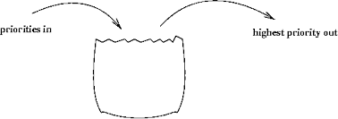
Priority Queues (2)
Fundamentally different from position based data structures such as stacks, queues, lists, and trees which store elements at specific positions (often in a linear arrangement)

Slide 6
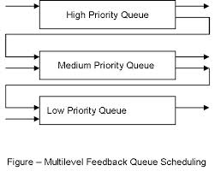
Priority Queue (3)
A regular queue is a first-in and first-out data structure
Elements are appended to the end of the queue and are removed from the beginning of the queue
In a priority queue, elements are assigned priorities
When accessing elements, the element with the highest priority is removed first

Slide 7
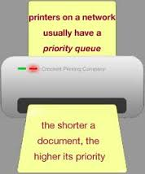
Applications of Priority Queues
The emergency room in a hospital assigns patients with priority numbers
The patient with the highest priority is treated first
Standby flyers
Stock market
Limit orders

Slide 8

Priority Queue Fundamentals
A priority queue is a container of elements each associated with a key
Typically, an entry is a pair (key, element)
The element stores the data
A key defines the priority ordering

Slide 9

Keys Definition
Keys
An object that is assigned to an element as a specified attribute of the element which an order is defined
Used to identify the rank or weight corresponding to an element
May and may not represent a property that the element did not originally process

Slide 10

Distinct Entries
Two distinct entries in a priority queue can have the same keys
Key values can be changed by an application
Often complex
Often composed of several data values

Slide 11

Total Order Relations
A priority queue needs a comparison rule, ≤, that will never contradict itself
The rules must be a total order relations
Must be true for every pair of keys
Defines a linear ordering relationship

Slide 12

Total Order Relations Properties
Reflexive property k ≤ k
Anti-symmetric property if k₁ ≤ k₂ and k₂ ≤ k₁ ⇒ k₁ = k₂
Transitive property if k₁ ≤ k₂ and k₂ ≤ k₃ ⇒ k₁ ≤ k₃
Given a finite collection, there is a well defined k_{min} such that k_{min} ≤ k for all keys

Slide 13

Comparators
A comparator encapsulates the action of comparing two objects according to a given total order relation

Slide 14

Comparator Options
Provide a generic (template) compare function that compares keys
Develop a specific lessThan or greaterThan method for each priority queue
Might want to overload the > or < operators
Implement a generic boolean function isLess(p,q) method that tests whether p < q
Can derive other relations from this:
(p == q) is equivalent to (!isLess(p, q) && !isLess(q, p))
Can be implemented in C++ by overloading “()”

Slide 15

Key Comparison Example
Given keys 4 and 11
If the keys are integers
4 ≤ 11
If the keys are strings (lexicographic order – extension of alphanumeric ordering)
“11” ≤ “4”

Slide 16
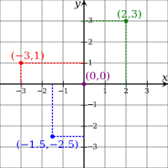
Comparator Example
Suppose that class Point2D defines a two dimensional point
It two public members getX() and getY() which accesses its x and y coordinates respectively
Can overload the < operator
bool operator < (const Point2d &p, const Point2d &q)
{
if p.getX() == q.getX() return p.getY() < q.getY();
else return p.getX() < q.getX();
}

Slide 17
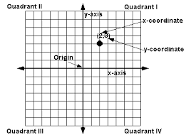
Defining and Using Comparator Objects
Suppose that class Point2D defines a two dimensional point
Given two objects p and q of type Point2D
To test if p is to the left of q, invoke leftRight(p,q)
Compares the x coordinates
To test if p is below q, invoke bottomTop(p,q)
Compares the y coordinates
Each invokes the () operator for the corresponding class

Slide 18
Point2D Comparators
class LeftRight { // left-right comparator
public:
bool operator()(const Point2D& p, const Point2D& q) const
{ return p.getX() < q.getX(); } // x values
};
class BottomTop { // bottom-top
public:
bool operator()(const Point2D& p, const Point2D& q) const
{ return p.getY() < q.getY(); } // y values
};
8.1
The above classes store no data
Purpose is to specify a comparison operator

Slide 19

Determining the Smaller Element
printSmaller() is a function to determine the smaller element
template <typename E, typename C>// element type and comparator
void printSmaller(const E& p, const E& q, const C& isLess) {
cout << (isLess(p, q) ? p : q) << endl;// print the smaller of p and q
}

Slide 20

The Client to Determine the Smaller Element
Point2D p(1.3, 5.7), q(2.5, 0.6); // two points
LeftRight leftRight; // a left-right comparator
BottomTop bottomTop; // a bottom-top comparator
printSmaller(p, q, leftRight); // outputs: (1.3, 5.7)
printSmaller(p, q, bottomTop); // outputs: (2.5, 0.6)
8.3

Slide 21

Priority Queue ADT Methods
insert(e): inserts an entry e (with an implicit associated key value) into the priority queue P
min(): returns, but does not remove, an entry with smallest key
removeMin(): remove from P the element min()
size(): returns the number of elements in P
empty(): returns true if P is empty, otherwise false

Slide 22

Priority Queue Example

Slide 23
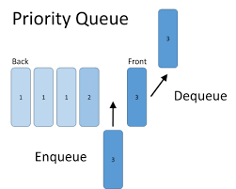
Priority Queue Interface
template <typename E, typename C>// element and comparator
class PriorityQueue { // priority-queue interface
public:
int size() const; // number of elements
bool isEmpty() const; // is the queue empty?
void insert(const E& e); // insert element
const E& min() const throw(QueueEmpty); // minimum element
void removeMin() throw(QueueEmpty); // remove minimum
};
8.4

Slide 24

Priority Queue Sorting
We can use a priority queue to sort a set of comparable elements
Put the elements of a collection S into a empty priority queue by means of a series of insert (e)
Extract the elements from priority queue P in non-decreasing order by a series of min() and removeMin( )
The running time of this sorting method depends on the priority queue implementation

Slide 25
Priority Queue Sorting
Algorithm PriorityQueueSort(L, P)
Input: An STL list L of n elements and a priority queue, P, that compares elements using a total order relation
Output: The sort list L
while !L.isEmpty ()
e ← L.front
L.pop_front()
P.insert(e)
while !P.isEmpty() do
e ← P.min()
e ← P.removeMin()
L.push_back(e)
8.5

Slide 26
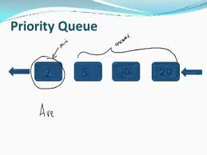
The STL priority_queue Class
The class priority_queue is a STL container class
The header file <queue> defines a template class for implementing a container (resizable array)
#include <queue>
using namespace std;
priority_queue <type> myPriorityQueue;

Slide 27
The STL priority_queue Methods
push(e): inserts an element in the priority queue
object pop(): removes the element at the top of the priority queue
object top(): returns a constant reference to the largest element of the priority queue
integer size(): returns the number of elements stored
boolean empty(): indicates whether no elements are stored

Slide 28
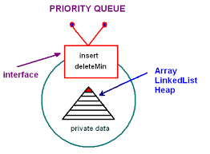
Priority Queue STL Example
priority_queue<Point2D, vector<Point2D>, LeftRight> p2;
p2.push( Point2D(8.5, 4.6) ); // add three points to p2
p2.push( Point2D(1.3, 5.7) );
p2.push( Point2D(2.5, 0.6) );
cout << p2.top() << endl; p2.pop(); // output: (8.5, 4.6)
cout << p2.top() << endl; p2.pop(); // output: (2.5, 0.6)
cout << p2.top() << endl; p2.pop(); // output: (1.3, 5.7)
8.6

Slide 29
Implementing a Priority Queue with a List
Implementation with an unsorted list
Performance:
insert() takes O(1) time since we can insert the item at the beginning or end of the sequence
removeMin() and min() take O(n) time since we have to traverse the entire sequence to find the smallest key
Implementation with a sorted list
Performance:
insert() takes O(n) time since we have to find the place where to insert the item
removeMin() and min() take O(1) time, since the smallest key is at the beginning
4
5
2
3
1
1
2
3
4
5
The above can be implemented using the STL list class

Slide 30
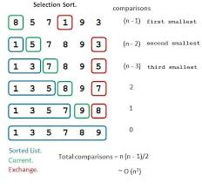
Selection-Sort
Selection-sort is the variation of priority queue sort where the priority queue is implemented with an unsorted sequence
Running time of Selection-sort:
Inserting the elements into the priority queue with n insert operations takes O(n) time
Removing the elements in sorted order from the priority queue with n removeMin() operations takes time proportional to 1 + 2 + …+ n
Repeated “selection” of the minimum element for the unsorted list)
Selection-sort runs in O(n²) time

Slide 31
Selection-Sort Example
Sequence S Priority Queue P
Input: (7,4,8,2,5,3,9) ()
Phase 1
(a) (4,8,2,5,3,9) (7)
(b) (8,2,5,3,9) (7,4)
.. .. ..
(g) () (7,4,8,2,5,3,9)
Phase 2
(a) (2) (7,4,8,5,3,9) (n)
(b) (2,3) (7,4,8,5,9) (n-1)
(c) (2,3,4) (7,8,5,9) (n-2)
(d) (2,3,4,5) (7,8,9) (n-3)
(e) (2,3,4,5,7) (8,9)
(f) (2,3,4,5,7,8) (9)
(g) (2,3,4,5,7,8,9) ()

Slide 32
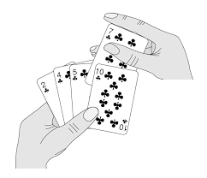
Insertion-Sort
Insertion-sort is the variation of priority queue sort where the priority queue is implemented with a sorted sequence
Running time of Insertion-sort:
Inserting the elements into the priority queue with n insert operations takes time proportional to
1 + 2 + …+ n
Removing the elements in sorted order from the priority queue with a series of n removeMin() operations takes O(n) time
Insertion-sort runs in O(n²) time

Slide 33
Insertion-Sort Example
Sequence S Priority queue P
Input: (7,4,8,2,5,3,9) ()
Phase 1
(a) (4,8,2,5,3,9) (7) (1)
(b) (8,2,5,3,9) (4,7) (2)
(c) (2,5,3,9) (4,7,8)
(d) (5,3,9) (2,4,7,8)
(e) (3,9) (2,4,5,7,8)
(f) (9) (2,3,4,5,7,8)
(g) () (2,3,4,5,7,8,9) (n)
Phase 2
(a) (2) (3,4,5,7,8,9)
(b) (2,3) (4,5,7,8,9)
.. .. ..
(g) (2,3,4,5,7,8,9) ()

Slide 34
In-place Insertion-Sort
Instead of using an external data structure, one can implement selection-sort and insertion-sort in-place
A portion of the input sequence itself serves as the priority queue
For in-place insertion-sort
We keep sorted the initial portion of the sequence
We can use swaps instead of modifying the sequence
5
4
2
3
1
5
4
2
3
1
4
5
2
3
1
2
4
5
3
1
2
3
4
5
1
1
2
3
4
5
1
2
3
4
5

Slide 35
Heaps
2
5
6
9
7

Slide 36

Recall Priority Queue Sorting
One uses a priority queue
Insert the elements with a series of insert operations
Remove the elements in sorted order with a series of removeMin() operations
The running time depends on the priority queue implementation:
Unsorted sequence gives selection-sort: O(n²) time
Sorted sequence gives insertion-sort: O(n²) time
Can one do better?

Slide 37

Improving the Running Time
A more efficient realization of a priority queue uses a data structure called a heap
Allows both insertions and removals in logarithmic time
Significant improvement over n² time
Entries are stored in a binary tree rather than a list

Slide 38
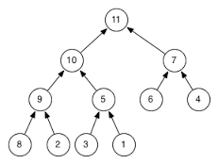
Heaps
A useful data structure for designing efficient sorting algorithms and priority queues
Is a binary tree with the following properties
A complete binary tree
A binary tree is complete if every level of the tree is full except that the last level (may not be full)
All the leaves on the last level are placed left-most
If h is the height of the heap
Then for i = 0, … , h - 1, the maximum number of nodes at level i is 2^{i}
Note: Not related to a memory heap

Slide 39
More on Heaps
For every internal node v other than the root, key(v) ≥ key(parent(v))
Minimum key is at the root
This is arbitrary (in some implementations, the maximum key is at the root - key(parent(v)) ≥ key(v))
STL heap
The last node of a heap is the rightmost node at depth h
(2,C)
top of the heap
(6,C)
(5,A)
(7,C)
(9,C)
last node

Slide 40
Height of a Heap
Theorem: A heap storing n keys has height O(log n)
Proof: (we apply the complete binary tree property)
Let h be the height of a heap storing n keys
Since there are 2^{i} keys at depth i = 0, … , h - 1 and at least one key at depth h, we have n ≥ 1 + 2 + 4 + … + 2^{h-1} + 1 = (2^{h} - 1) +1= 2^{h}
Thus, n ≥ 2^{h} , i.e., h ≤ log n
depth
keys
0
1
1
2
h−1
2^{h−1}
h
1
Updates run in a time proportional to the height of a heap and run in logarithmic time

Slide 41
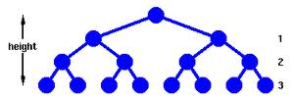
Complete Binary Tree
If the bottom level of a tree T is not full, then add a new node on the bottom level of T immediately after the rightmost node of this level (the last node)
If the bottom level is full, then add a new node as the left child of the leftmost node of T
Height increases by one

Slide 42
Vector-based Heap Implementation
One can represent a heap with n keys by means of a vector of length n + 1
If v is the root, then f(v)=1
If v is the left child node of u, then f(v)=2f(u)
If v is the right child node of u, then f(v)=2f(u)+1
With this scheme, the nodes of T have contiguous indices in the range of [1,n] and the last node is always at index n
2
5
6
9
7
2
5
6
9
7
0
1
2
3
4
5

Slide 43
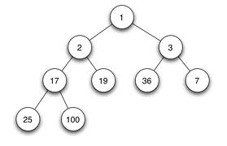
Heaps and Priority Queues
One can use a heap to implement a priority queue, T
Heap
One stores a (key, element) item at each internal node
One implements the heap using a vector
For each node of T, the key is denoted by k(v)
Comparator
Defines the total order relationship

Slide 44
Heaps and Priority Queues
Method min() is performed in O(1) time
Accesses the root
(2, Bill)
(5, Pat)
(6, Mark)
(9, Jeff)
(7, Anna)

Slide 45
Insertion into a Heap
The insertion algorithm consists of three steps
Find the insertion node z (the new last node)
Store k at z
Restore the heap-order property
2
5
z
6
9
7
insertion node
2
5
6
z
9
7
1

Slide 46
Insertion into a Heap
If the bottom level is not full, then add the new node on the bottom immediately after the right-most node (last node)
If the bottom level is full, start a new level
2
5
z
6
9
7
insertion node
2
5
6
z
9
7
1

Slide 47
Up-heap Bubbling
After the insertion of a new key k, the heap-order property may be violated
Algorithm up-heap restores the heap-order property by swapping k along an upward path from the insertion node
Up-heap terminates when the key k reaches the root or a node whose parent has a key smaller than or equal to k
Since a heap has height O(log n), up-heap runs in O(log n) time
2
1
5
1
5
2
z
z
9
7
6
9
7
6

Slide 48
Insertion into a Heap
If the bottom is full, then add the new node as the left child of the left most node of the bottom of T
Height is increased by 1
2
5
6
9
7
12
11
z
insertion node
2
5
6
9
7
12
11
z
10

Slide 49
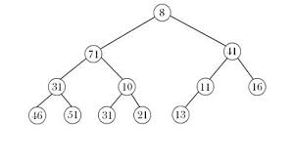
Adding Elements to the Heap (1)
Add 3, 5, 1, 19, 11, 22, and 88 to a heap, initially empty (see next slide)
Use a reverse comparator (largest key is at the root)

Slide 50
Adding Elements to the Heap (2)
Adding 3, 5, 1, 19, 11, 22, and 88 to a heap, initially empty
3
3
5
5
5
5
3
3
1
3
1
19
19
19
5
5
1
5
1
19
1
3
11
3
3
Uses a reverse comparator

Slide 51
Adding Elements to the Heap (3)
Adding 3, 5, 1, 19, 11, 22, and 88 to a heap, initially empty
19
19
19
5
1
11
1
11
22
3
11
3
5
22
3
5
1
22
11
19
3
5
1
Uses a reverse comparator

Slide 52
Adding Elements to the Heap (4)
Adding 3, 5, 1, 19, 11, and 22 to a heap, initially empty
22
22
88
11
19
11
88
11
22
3
5
1
88
3
5
1
19
3
5
1
19
Uses a reverse comparator

Slide 53
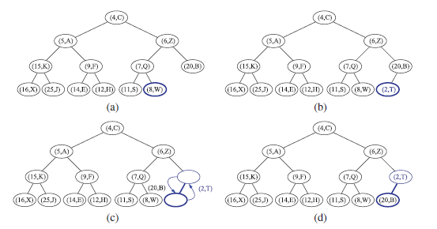

Heap Insertion Example (1)

Slide 54
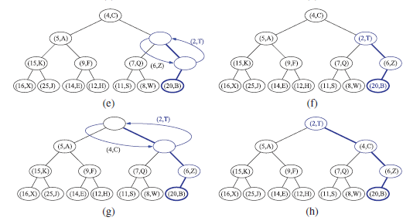
Heap Insertion Example (2)

Slide 55
Removal from a Heap
Method removeMin( ) of the priority queue ADT corresponds to the removal of the root key from the heap
The removal algorithm consists of three steps
Replace the root key with the key of the last node w
Remove w
Restore the heap-order property
2
5
6
w
9
7
last node
7
5
w
6
9
new last node

Slide 56

Down-Heap Bubbling
After replacing the root key with the key k of the last node, the heap-order property may be violated
Two cases
If r (root) has no right child, let s be the left child of r
Otherwise (r has both children), let s be the child with the smallest key
If k(r) ≤ k(s) then the heap order is satisfied and the algorithm is complete
If k(r) > k(s) then the heap order must be restored
Down-heap terminates when key k reaches a leaf or a node whose children have keys greater than or equal to k
Since a heap has height O(log n), down-heap runs in O(log n) time

Slide 57
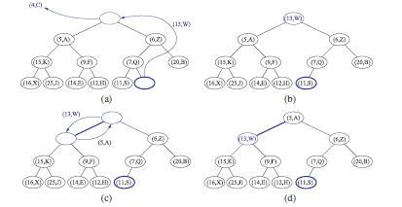

Down-Heap Bubbling

Slide 58
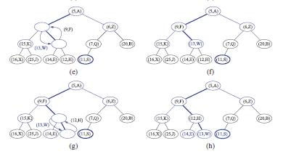
Down-Heap Bubbling

Slide 59
Merging Two Heaps
k = 7 in this example
Given two heaps and a key k
One can create a new heap with the root node storing k and with the two heaps as sub-trees
One performs a down-heap to restore the heap-order property
3
2
8
5
4
6
7
3
2
8
5
4
6
2
3
4
8
5
7
6

Slide 60
Bottom-up Heap Construction
One can construct a heap storing n given keys in using a bottom-up construction with log n phases
In phase i, pairs of heaps with 2^{i} -1 keys are merged into heaps with 2^{i+1}-1 keys
2^{i} −1
2^{i} −1
2^{i+1}−1

Slide 61

Bubble-Up Heap Construction
A heap can be constructed in O(n log n) time by n successive insert operations and then use the heap to extract the elements in order
However if all the elements to be stored in a heap are given in advance, the construction algorithm can run in O(n) time

Slide 62

Bubble-Up Heap Construction
Construct (n+1)/2 elementary heaps storing one entry in each (a)
Construct (n+1)/4 elementary heaps each storing three entries (b and c)
Construct (n+1)/8 elementary heaps (d and e)
Join the two heaps (f and g)

Slide 63
Bottom-up Heap (1)
n = 15
(a)
16
15
4
12
6
7
23
20
height=3
(b)
25
5
11
27
16
15
4
12
6
7
23
20

Slide 64
Bottom-up Heap (2)
n = 15
(b)
25
5
11
27
16
15
4
12
6
7
23
20
(c)
15
4
6
20
16
25
5
12
11
7
23
27

Slide 65
Bottom-up Heap (3)
(d)
9
8
15
4
6
20
16
25
5
12
11
7
23
27
(e)
4
6
15
5
7
20
16
25
9
12
11
8
23
27

Slide 66
Bottom-up Heap (4)
(f)
14
4
6
15
5
7
20
16
25
9
12
11
8
23
27
4
(g)
7
6
Complete
15
9
7
20
16
25
14
12
11
8
23
27

Slide 67
Heap-Sort
Consider a priority queue with n items implemented by means of a heap
The space used is O(n)
Methods insert() and removeMin() take O(log n) time
Methods size(), empty(), and min() take time O(1) time
Using a heap-based priority queue, we can sort a sequence of n elements in O(n log n) time (n * log n operations)
The resulting algorithm is called heap-sort
Heap-sort is much faster than quadratic sorting algorithms, such as insertion-sort and selection-sort - O(n²)

Slide 68

In-Place Heap-sort
Uses less storage
Doesn’t need to move elements in and out of the heap
Just rearranges the elements
The following example using a reverse comparator (see next page)

Slide 69
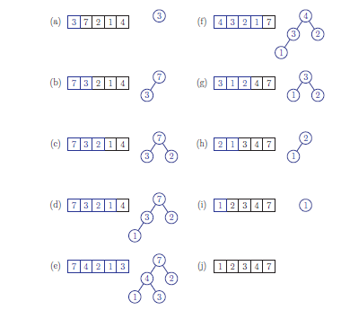
In-place Heap-sort
Figure 8.9

Slide 70
A Heap-Based Priority Queue Implementation
template <typename E, typename C>
class HeapPriorityQueue {
public:
int size() const; // number of elements
bool empty() const; // is the queue empty?
void insert(const E& e); // insert element
const E& min(); // minimum element
void removeMin(); // remove minimum
private:
VectorCompleteTree<E> T; // priority queue contents
C isLess; // less-than comparator
// shortcut for tree position
typedef typename VectorCompleteTree<E>::Position Position;
};
8.14

Slide 71
Adaptable Priority Queues
3
a
5
g
4
e

Slide 72

When a Priority Queue is not Sufficient: Airline Passengers
Case 1:
When a standby passenger gets discouraged and requests to be removed from the standby list
The only way to remove an entry from a priority queue is with the removeMin() method
Not applicable in this case
Case 2:
When another passenger finds their gold frequent-flyer card
Priority needs to be changed
There is not a method to support this change

Slide 73

When a Priority Queue is not Sufficient: Stock Market
Online trading system where orders to purchase and sell a stock are stored in two priority queues (one for sell orders and one for buy orders) as (p,s) entries:
The key, p, of an order is the price
The value, s, for an entry is the number of shares
A buy order (p,s) is executed with a sell order (p’,s’) if p’<p (sell price< buy price)
The execution is complete if s’>s
A sell order (p,s) is executed with a buy order (p’,s’) if p’>p (sell price> buy price)
The execution is complete if s’>s
What happens if there are changes?

Slide 74
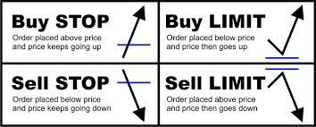
Changing the Orders
What if someone wishes to cancel their order before it executes?
What if someone wishes to update the price or number of shares for their order?
A priority queue cannot handle the above situations

Slide 75
Priority Queue ADTs Revisited
A priority queue stores a collection of entries
Typically, an entry is a pair (key, value), where the key indicates the priority
The priority queue is associated with a comparator C, that compares two entries
Priority Queue ADT:
insert(e) inserts entry e
removeMin() removes the entry with smallest key
min() returns, but does not remove, an entry with smallest key
size(), empty()

Slide 76

Adaptable Priority Queue ADT
To support changing priorities or removing specified entries
An Adaptable Priority Queue can be used

Slide 77

Adaptable Priority Queue Capabilities Needed
There is a need to modify or remove specified entries
Cannot just use an entry’s key because keys are not distinct
The insert method is augmented to return a reference to the newly created entry (position)
This position is permanent so even if the location of the entry changes (bubble up or bubble down), the position does not change
The position provides a means to uniquely identify an entry

Slide 78
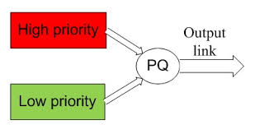
Additional Adaptable Priority Queue (P) ADT Methods
replace(p,e)
Replace with e the element associated with the entry reference by position p and return the position of the altered entry
remove(p)
Removes the entry referenced by p (position) from P
insert(e)
Inserts the element e into P and returns the position to its entry (new capability)

Slide 79
Adaptable Priority Queue Example
Operation Output P
insert(5,A) p₁ (5,A)
insert(3,B) p₂ (3,B), (5,A)
insert(7,C) p₃ (3,B), (5,A), (7,C)
min() p₂ (3,B), (5,A), (7,C)
remove(p₁) – (3,B), (7,C)
replace(p₂,(9,D)) p₄ (7,C), (9,D)
replace(p₃,(7,E)) p₅ (7,E), (9,D)
remove(p₄) – (7,E)

Slide 80
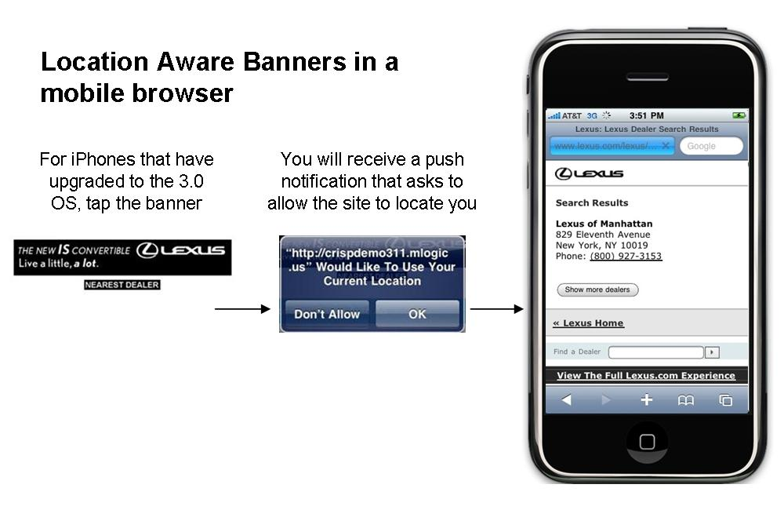
Locating Entries
In order to implement the operations remove(p) and replace(p,e), and one needs a fast way of locating an entry p in a priority queue

Slide 81
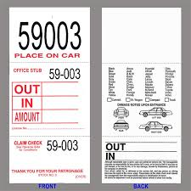
Location-Aware Entries
A location-aware entry identifies and tracks the location of its (key, value) object within a data structure
Examples:
Coat claim check
Valet claim ticket
Reservation number
Main idea
Since entries are created and returned from the data structure itself, it can return location-aware entries, thereby making future updates easier

Slide 82

Location-Aware Entries - 1
In order to deal with moving entries in a adaptable priority queue
Each time one inserts a new element
A locator object is created
An location aware entry is created
Stores the current position of the element
Each entry needs to know its associated locator

Slide 83
Location-Aware Entries - 2
To access an entry, one first accesses the locator object
If an entry moves, one modifies location aware entry to point to the new locator
Only a constant number of pointers need to be updated

Slide 84
List Implementation of Location-Aware Entries
A location-aware list entry is an object storing
Key
Value
Position (or rank) of the item in the list
The position (or array cell) stores the entry
Back pointers (or ranks) are updated during swaps
header
location-aware entries
trailer
2
c
4
d
5
d
8
f
entries

Slide 85
Heap Implementation of Location-Aware Entries
A location-aware heap entry is an object storing
Key
Value
Position of the entry in the underlying heap
Each heap position stores an entry
Back pointers are updated during entry swaps
2
d
4
a
6
b
8
g
5
e
9
c

Slide 86
Performance of Adaptable Priority Queue
Improved times due to location-aware entries are highlighted in yellow
Method Unsorted List Sorted List Heap
size, empty O(1) O(1) O(1)
insert O(1) O(n) O(log n)
min O(n) O(1) O(1)
removeMin O(n) O(1) O(log n)
remove O(1) O(1) O(log n)
replace O(1) O(n) O(log n)

